Slide 1
Daily Review
The first part of the scientific method involves:
a question to answer
an aim for an experiment or investigation
a hypothesis for an investigation
An aim is short sentence describing briefly what you are trying to find out from the experiment.
A hypothesis is a statement that can be tested and involves the relationship between two variables.
Vocabulary
Hypothesis: a testable statement
Notes:
45 s → share → popsticks

Slide 2
Daily Review
An aim is short sentence describing briefly what you are trying to find out from the experiment.
On your white boards write which of the following could be an aim for an investigation:
To find out if the temperature of the milk affects how fast milo dissolves.
To find out if the amount of sunlight affects how tall a plant grows
To find out if caterpillars prefer to eat rose leaves.
Vocabulary
Hypothesis: a testable statement
Notes:
45 s → share → popsticks

Slide 3
Daily Review
The Hypothesis is a testable statement relating the independent variable (stated first) to the dependent variable.
On your white boards write which of the following could be an hypothesis for an investigation:
I think that milo dissolves faster in hot milk.
The more sunlight a plant gets, the taller it grows.
Caterpillars don’t like rose leaves because they are spikey.
Vocabulary
Hypothesis: a testable statement
Notes:
45 s → share → popsticks

Slide 4
Daily Review
There are three types of variables in an experiment.
Independent variable: the one that is deliberately changed
Dependent variable: the one that is tested or measured
Controlled variables: the ones that are kept the same to make the experiment fair
The HYPOTHESIS is a testable statement relating the independent variable (stated first) to the dependent variable.
Vocabulary
Hypothesis: a testable statement
Notes:
45 s → share → popsticks

Slide 5
Daily Review
There are three types of variables in an experiment. Match the variables to their examples
Aim: To find out if smaller pieces of ice melt faster than larger pieces.
Independent
Dependent
Controlled
Temperature of surface
Size of ice pieces
Time taken for ice to melt
Substance used to make ice
Vocabulary
Hypothesis: a testable statement
Notes:
45 s → share → popsticks

Slide 6
Types of Forces: Friction Year 7 Science

Slide 7
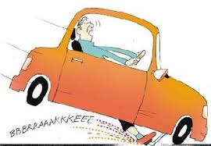
Learning Objectives
CFU
In your own words: what are we going to learn?
Plan and conduct an investigation into the effect of friction on braking distance.
Activate Prior Knowledge
Think, pair share:
Which do you think will stop faster: A truck or a bike? A car driving on gravel or a car on a road? A car with new tyres or a car with old tyres?

Slide 8
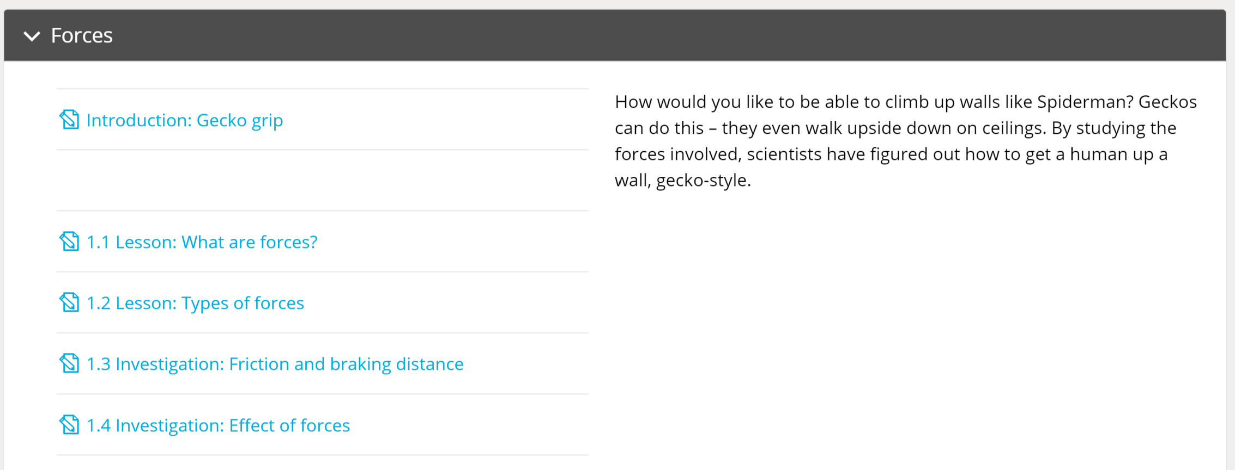
Independent Practice
Go to www.stileapp.com
Use your student email to log in (or join using a class code)
Open the section Forces select lesson 1.3 – Investigating friction and braking distance.
You will be completing the braking distances investigation

